Slide 1

Gitting Started
Data Science Initiative | Colby T. Ford, Ph.D.

Slide 2
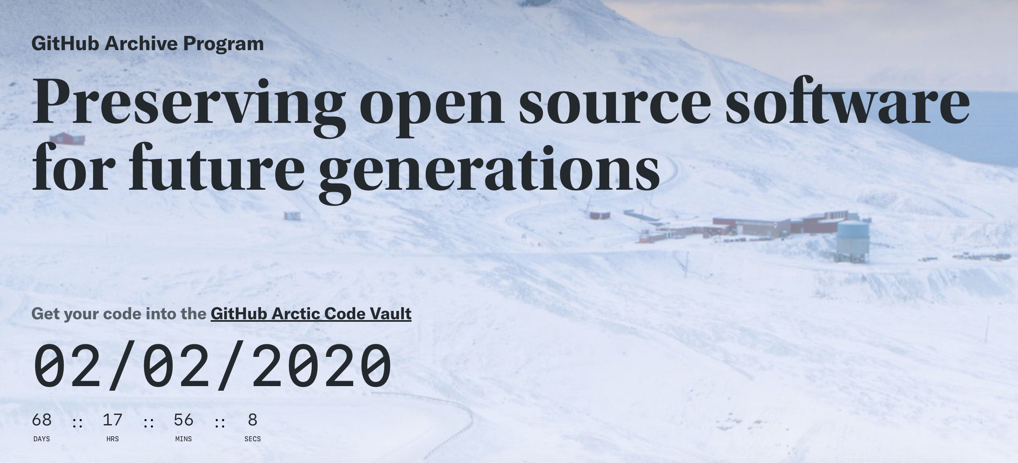
https://archiveprogram.github.com/

Slide 3

What is Git?
Version Control
Which changes were made?
Who made the changes?
When were the changes made?
Why were changes needed?
Terminology
Code is stored in a repository
If you want to use someone else’s code and make changes, you can fork it. Then, submit a pull request to try and merge the changes back in
Your team can work on separate branches of the same repository
Repositories are usually initialized with a README.md, a .gitignore, and a license.
https://www.youtube.com/watch?v=w3jLJU7DT5E

Slide 4
Commands
https://guides.github.com/introduction/git-handbook/
https://lab.github.com/githubtraining/introduction-to-github
git init
git clone
git commit
git status
git branch
git merge
git pull
git push
Initializes a brand new Git repository and begins tracking an existing directory
Creates a local copy of a project that already exists remotely
Saves the snapshot to the project history and completes the change-tracking process
Shows the status of changes as untracked, modified, or staged
Shows the branches being worked on locally.
Merges lines of development together
Updates the local line of development with updates from its remote counterpart
Updates the remote repository with any commits made locally to a branch.

Slide 5


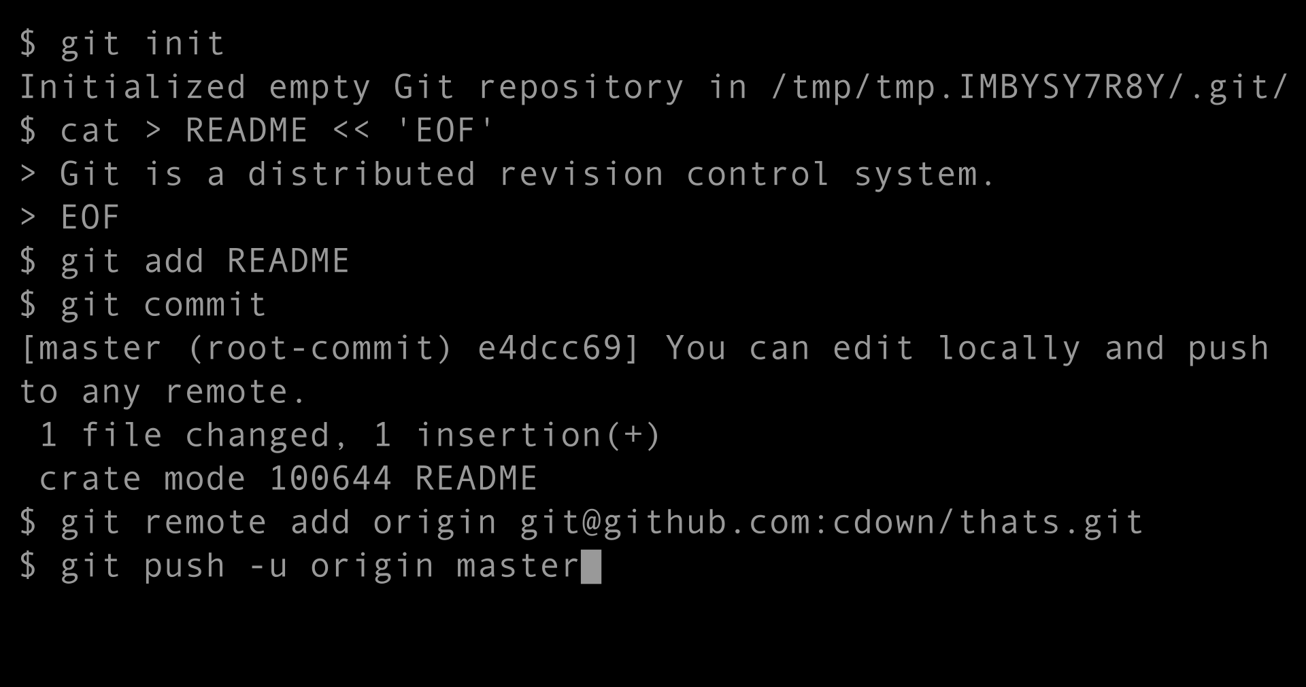





Various Tools to Git it Done
Git Clients
Repository Services

Slide 6


Learning Resources
https://guides.github.com/introduction/git-handbook/
https://lab.github.com/

Slide 7
First Day on GitHub
What is GitHub?
Hey, it's your first time here, so let's not take any chances. Check out this short video to understand why people use GitHub.
Introduction to GitHub
That video is pretty cool, right? If you want to learn how to use the workflow described in that video, take this course.
Git Handbook
By now you are probably wondering what a Git is and why it is important in writing code. We have you covered with this short article on version control with Git.
Communicating using Markdown
Uploading your project to GitHub
GitHub is all about collaboration and we collaborate in issues in pull requests. Learn how to get your point across with the worlds easiest text formatting syntax.
Now that you know what GitHub does, I bet you're ready to move all of those projects off your local machine. This course will show you how.
Link: https://lab.github.com/githubtraining/paths/first-day-on-github

